Slide 1
Employee Performance Analysis Using Excel
PRESENTED BY: RAKESH D
REGISTER NO.: 312204512
DEPARTMENT: COMMERCE
COLLEGE: K.C.S KASI NADAR COLLEGE OF ARTS AND SCIENCE

Slide 2
PROJECT TITLE
Employee Performance Analysis Using Excel

Slide 3
AGENDA
1.Problem Statement
2. Project Overview
3.End Users
4.Our Solution and Proposition
5. Dataset Description
6. Modelling Approach
7. Results and Discussion
8.Conclusion

Slide 4
PROBLEM STATEMENT
There are varying performance ratings across employees, with some receiving ratings of "Needs Improvement" and others rated as "Fully Meets." Identifying the reasons behind these disparities is essential for improving overall team performance.
Analysis is needed to evaluate if different business units or departments are performing efficiently and to identify any patterns related to performance ratings.
The employee data reflects different gender, race, and marital status distributions. Analyzing these factors is important to ensure that diversity and inclusion goals are being met and that there are no biases in employment practices.
Different business units and locations are represented in the data. Analyzing performance and employment trends across these units can identify areas of strength and those needing improvement.
Ensuring that the data reflects compliance with employment regulations, especially in terms of classifications, pay zones, and employee types.

Slide 5
PROJECT OVERVIEW
[Employee Performance Improvement and Pay Zone Optimization]
Begin with cleaning and preparing the data to ensure consistency and accuracy. Address missing values, incorrect entries, and ensure that all data fields are correctly formatted.
Analyze employee performance ratings and scores across various factors such as job function, employment type, and location. Identify patterns and correlations that explain performance discrepancies.
Investigate the reasons behind different termination types and statuses. Examine if certain employment types or statuses are associated with higher turnover rates or performance issues.
Assess the distribution of gender, race, and marital status within the employee population. Compare these distributions to industry standards and organizational goals to identify any areas requiring attention.
Evaluate the impact of different supervisors on employee performance ratings. Determine if certain supervisors consistently have higher or lower performance scores and investigate possible causes.

Slide 6
WHO ARE THE END USERS?
Human Resources (HR) Department
Department Managers (Sales & Production)
Senior Leadership/Executives
Employees
Finance/Compensation Teams

Slide 7
OUR SOLUTION AND ITS VALUE PROPOSITION
Filtering - Remove missing values.
Conditional Formatting - Blanks, Background Color Shading, Data Bars, Values.
Data Filtering and Sorting - Identify specific employee performance groups, such as those with exceeds, needs improvement and fully meets.
Pivot table - Summary of employee performance under their employee Id.
Graphs - Final Report with Trend line.

Slide 8
DATASET DESCRIPTION
EMPLOYEE ID: Unique identifier for each employee in the organization.
FIRST NAME: The first name of the employee.
PAY ZONE: The pay zone or salary band to which the employee's compensation falls.
DEPARTMENT TYPE: The broader category or type of department the employee's work is associated with.
CURRENT EMPLOYEE RATING: The current rating or evaluation of the employee's overall performance.

Slide 9
MODELLING
DATA SET: Kaggle, Employee dataset.
FEATURE SELECTION: Slicer, Conditional Formatting, Designing.
DATA CLEANING: Missing values, Irrelevant data, Correct Errors, Remove Unnecessary Columns and Rows.
PIVOT TABLE: Employee ID, First Name, Performance Score.
CHART: Report of Employee Performance based on their Employee Id is represent in Values and Performance Score presented as Column Chart.

Slide 10
RESULTS

Slide 11
CONCLUSION
The analysis will provide insights into the reasons behind performance disparities and offer recommendations for targeted interventions to improve overall performance.
The analysis will provide insights into the reasons behind performance disparities and offer recommendations for targeted interventions to improve overall performance.
The project will highlight any gaps in diversity and inclusion, offering recommendations for improving hiring practices and creating a more inclusive work environment.
Insights into supervisor effectiveness will inform management practices and help in designing training programs to enhance supervisory skills and support employee development.

Slide 12
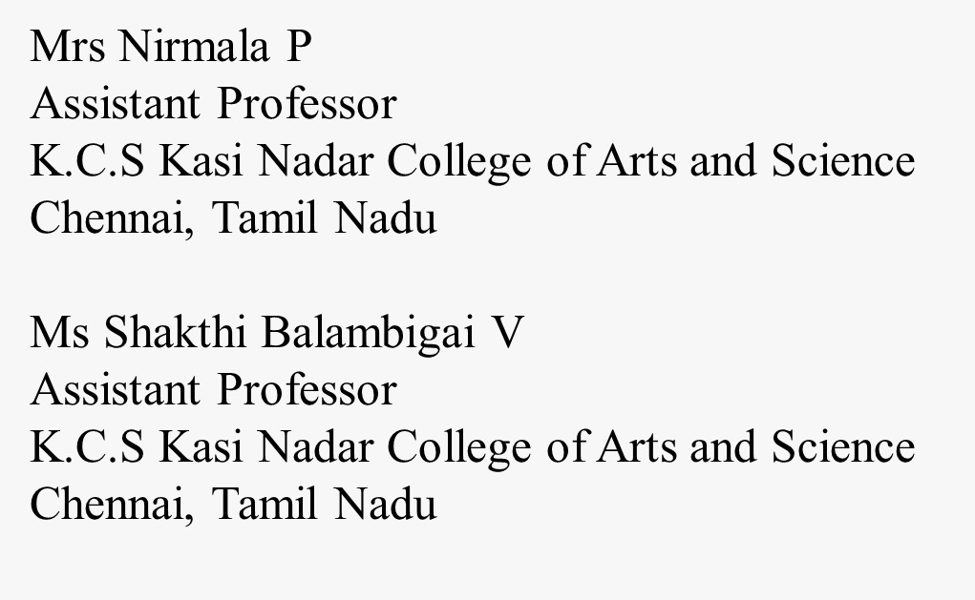
REFERENCE

